Slide 1
Introduction to Linux
Francisco Fuster Tormo
13 - 03 - 18
ffuster@carrerasresearch.org

Slide 2
What is Linux?
Operating System (OS) based on UNIX
Multiuser → Allows more than one user at the same time
Multitasking → Allows more than one program executed at the same time
Networking → Allows network access
Various user interfaces → Different “desktops” allowed
Other UNIX-based OS?
Mac OS
Android

Slide 3
How many Linux are?
Debian
Ubuntu
Linux Mint
Red Had
Fedora
OpenSuse
CentOS
Gentoo
...

Slide 4
Is Linux difficult to use?
Graphic User Interface (Desktop)

Slide 5
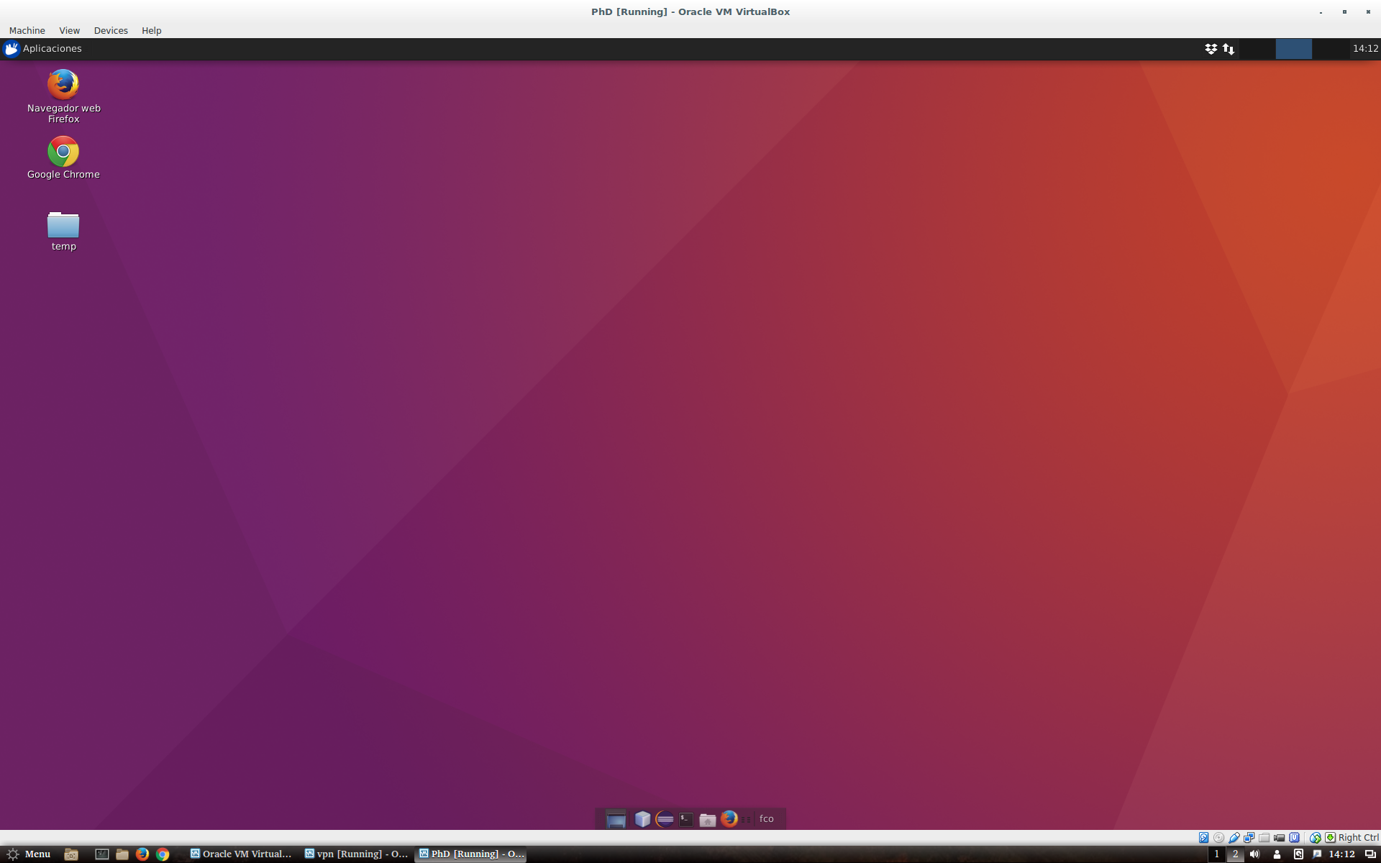
Is Linux difficult to use?
Graphic User Interface

Slide 6
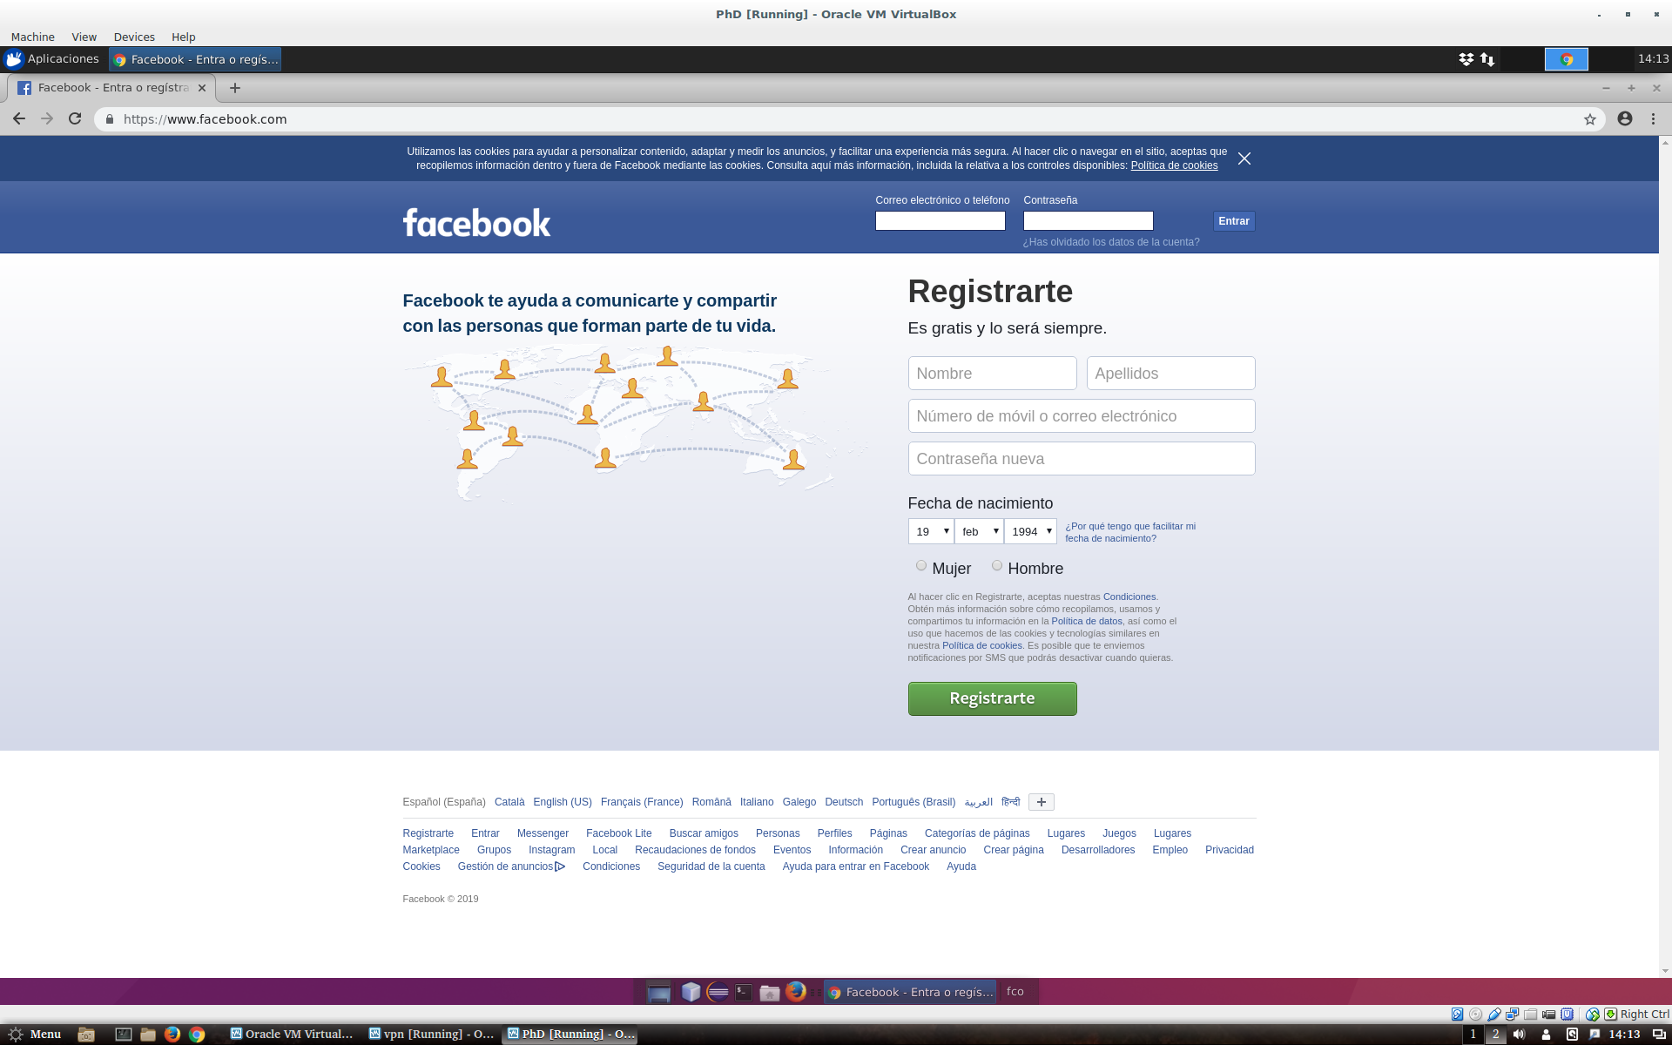
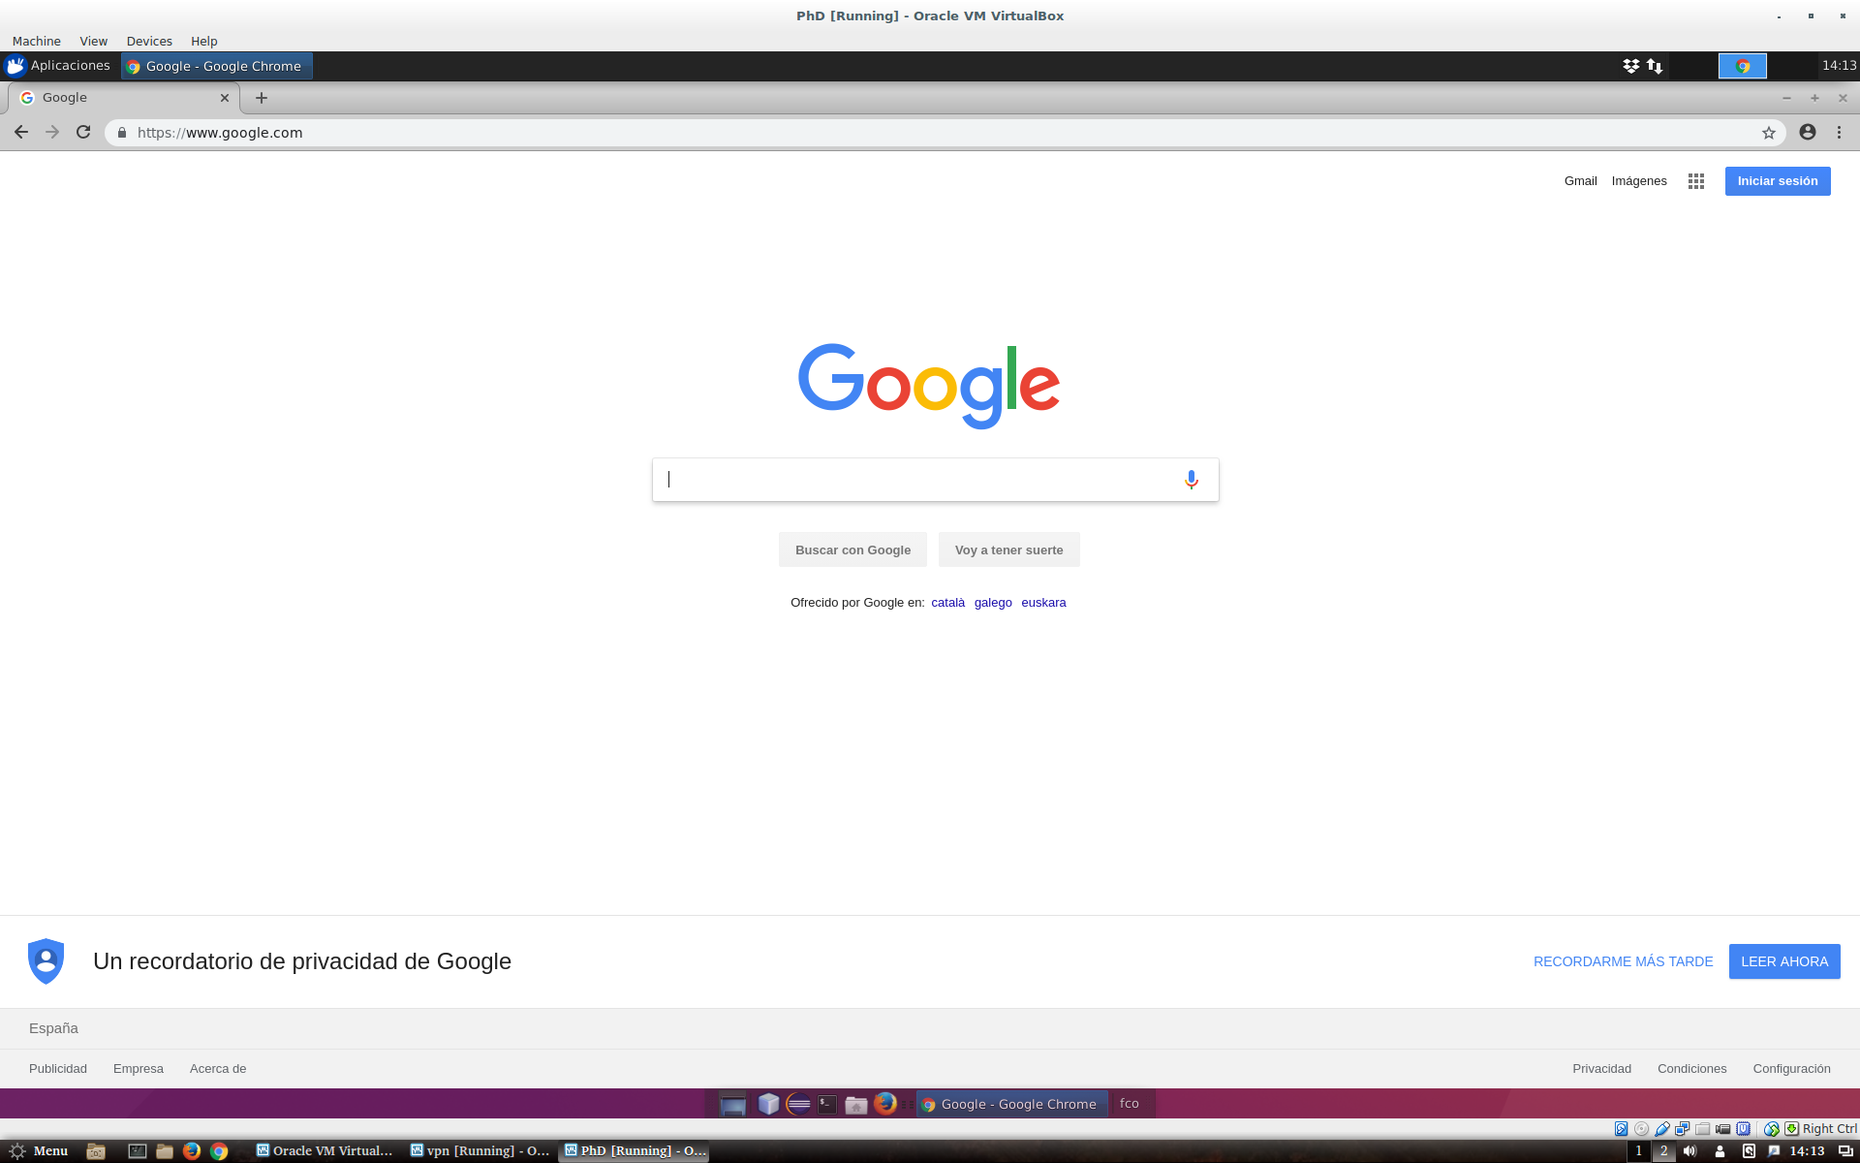
Is Linux difficult to use?
Graphic User Interface

Slide 7
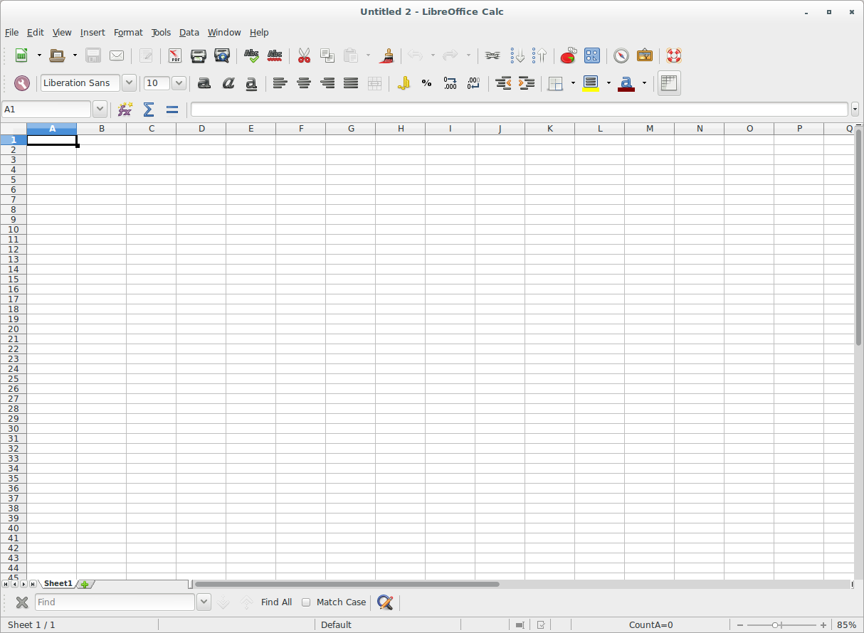
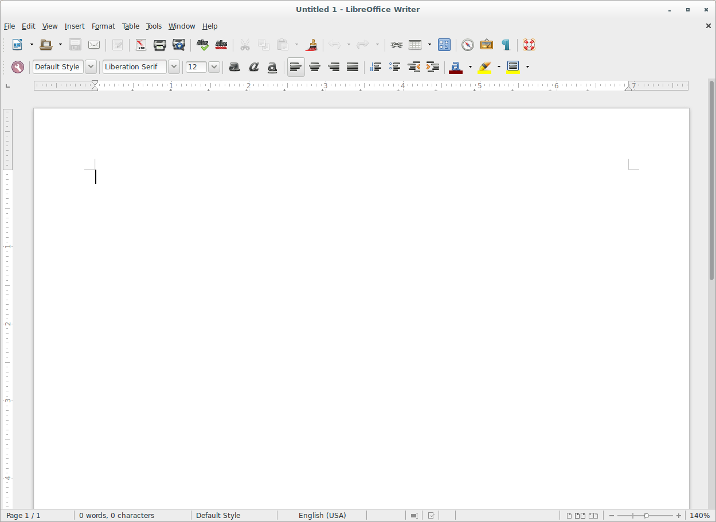
Is Linux difficult to use?
Graphic User Interface

Slide 8
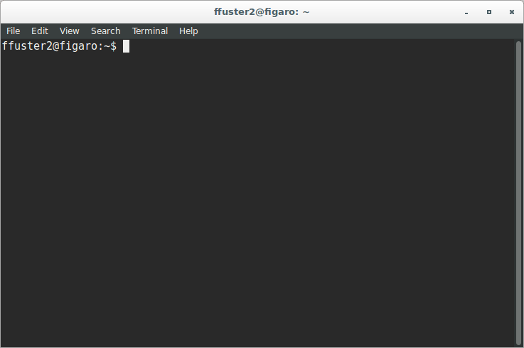
But...

Slide 9
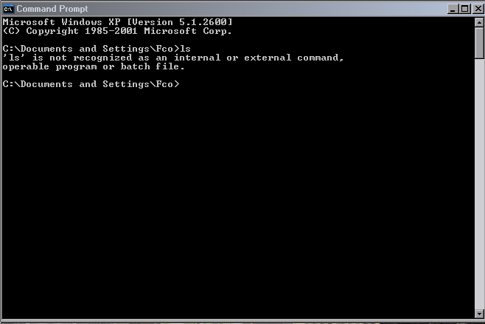
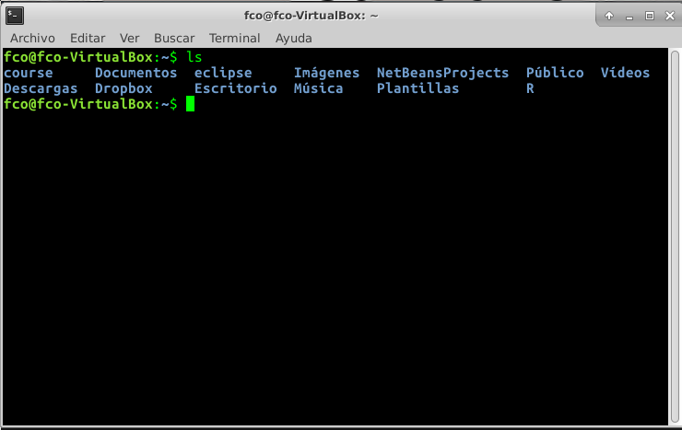
Differences between Windows & UNIX

Slide 10
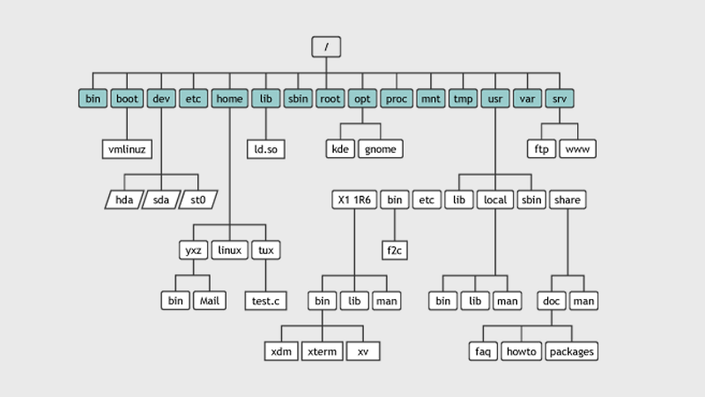
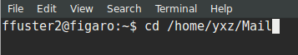
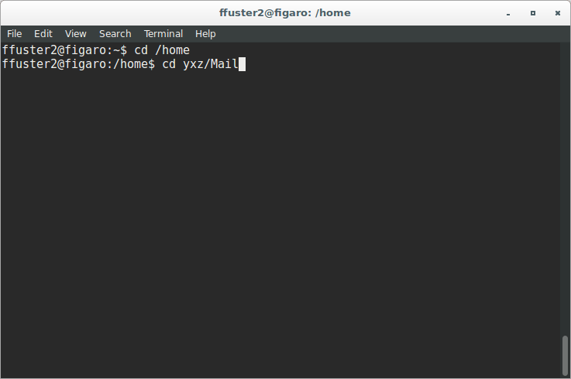
The Linux filesystem

Slide 11
Special considerations
command -x -y --option [other_parameters]
Command is in bold
Other parameters are surrounded by ‘[ ]‘. Square brackets are written just to distinguish between parameters
Command options start by ‘-’ or ‘--’

Slide 12
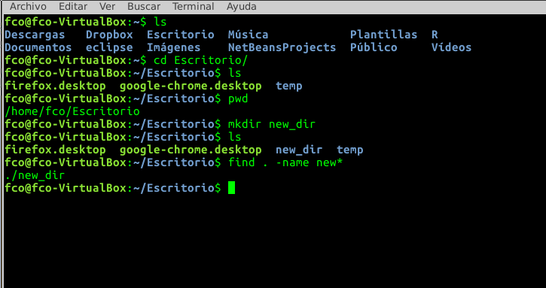
Linux basic commands (1). Folder navigation
cd [folder] → Navigation in directories
ls → List the files/directories in a path
pwd → Get absolute path of current directory
mkdir [folder_name] → creates the folder [folder_name] in the current path
find [path] -name [pattern] → Searches files in the specified position

Slide 13
Exercise (1)
Go to your home folder /home/user
Create the directory ‘course’ in you home folder
List all the elements you have in your home folder
Get absolute path of your folder

Slide 14
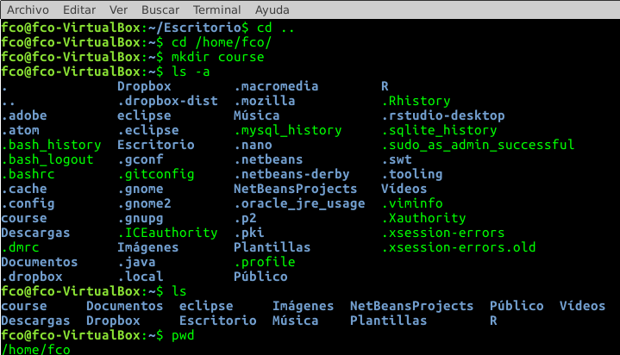
Exercise (1)
Go to your home folder /home/user
Create the directory ‘course’ in you home folder
List all the elements you have in your home folder
Get absolute path of your folder

Slide 15
Linux basic commands (2). Copy, move, remove files
touch [file_name] → creates an empty file called [file_name]
cp [file_origin] [file_destination] → copy [file_origin] in [file_destination]
rsync [origin_folder] [destination_folder] → Synchronize both folders
mv [file_origin] [file_destination] → move [file_origin] to [file_destination]
rm [file] → removes [file]

Slide 16
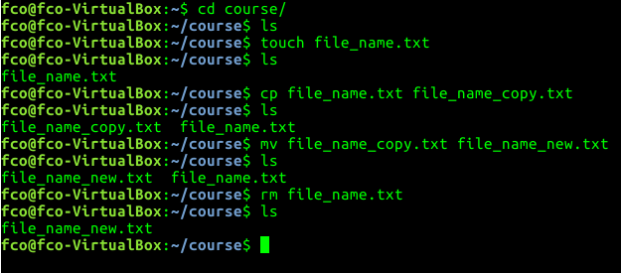
Linux basic commands (2). Copy, move, remove files
touch [file_name] → creates an empty file called [file_name]
cp [file_origin] [file_destination] → copy [file_origin] in [file_destination]
rsync [origin_folder] [destination_folder] → Synchronize both folders
mv [file_origin] [file_destination] → move [file_origin] to [file_destination]
rm [file] → removes [file]

Slide 17
Exercise (2)
Create a new file called ex2.sh in your home folder
Copy this file to your recently created folder
Remove the file from your home folder

Slide 18
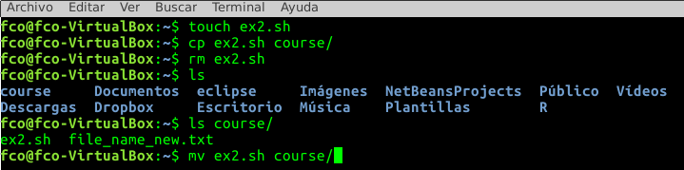
Exercise (2)
Create a new file called ex2.sh in your home folder
Copy this file to your recently created folder
Remove the file from your home folder

Slide 19
Exercise (2)
Create a new file called ex2.sh in your home folder
Copy this file to your recently created folder
Remove the file from your home folder

Slide 20
Linux commands (3). Working with files
head -n [number_of_lines] [file]→ Show first [number_of_lines] of the [file]
tail -n [number_of_lines] [file] → Show last [number_of_lines] of the [file]
cat [file] → Print all the file
less [fille] → Print all the file
grep [word] [file] → Find [word] in [file]
cut -f [columns] [file] → Show only [columns] of [file]
sort -k [column] [file]→ Sort the lines of a file by [column]
diff [file1] [file2] → Compare [file1] and [file2] line by line
uniq [file] → Report or omit repeated lines in file
tr → Translate or delete characters

Slide 21
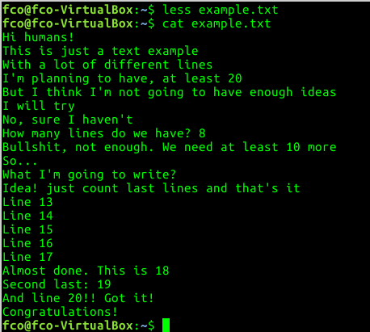
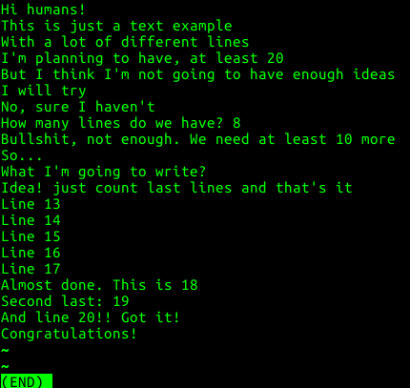
Examples (2)
cat & less

Slide 22
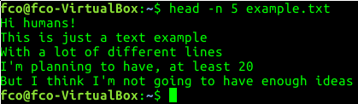
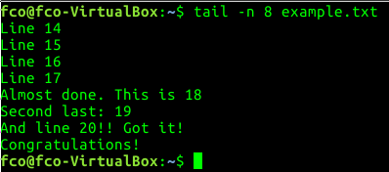
Examples
head & tail

Slide 23
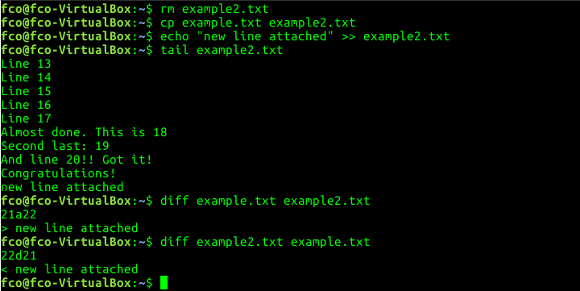
Examples (3)
diff

Slide 24
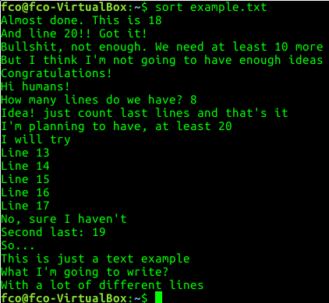
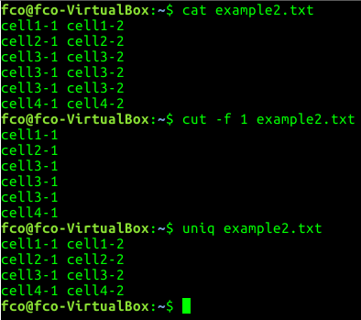
Examples (4)
sort, uniq & cut

Slide 25
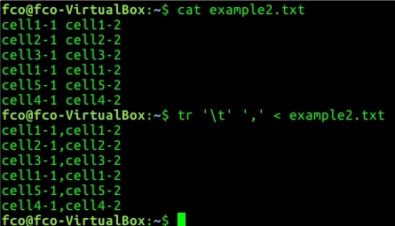
Examples (5)
tr

Slide 26
Exercise (3)
Copy exercise.tsv in course folder
Print last 10 lines of the file
Print 6th column of the file
Convert all the ‘:’ to ‘-’ in the file

Slide 27
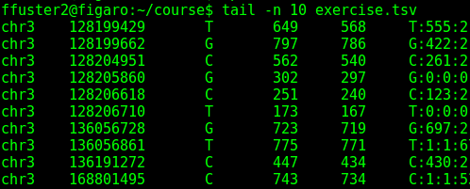
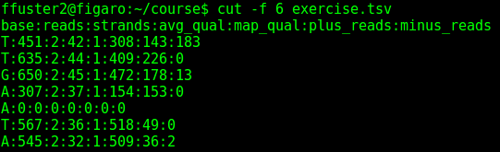
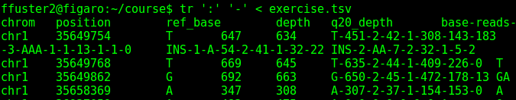
Exercise (3)
Copy exercise.tsv in course folder
Print last 10 lines of the file
Print 6th column of the file
Convert all the ‘:’ to ‘-’ in the file

Slide 28
Special characters
‘>’ [file] → Store the output in [file]
‘>>’ [file] → Append output to [file]
2> [file] → Store error output to [file]
2>> [file] → Append output error to [file]
‘<’ [file] → Use [file] as input
‘;’ → Separator between commands
‘|’ → Send the output to other program (pipe)
‘*’ → All characters

Slide 29
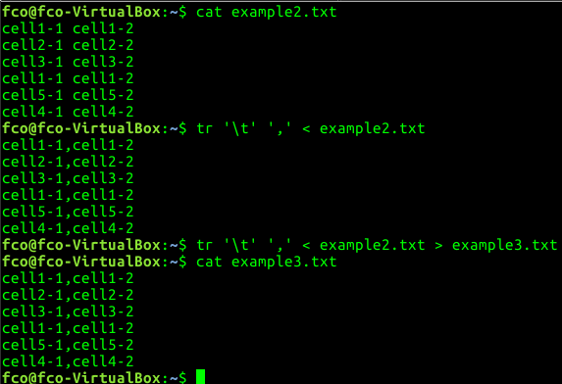
Examples

Slide 30
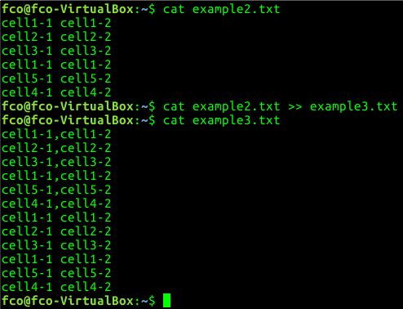
Examples

Slide 31
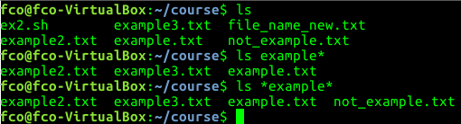
Examples

Slide 32
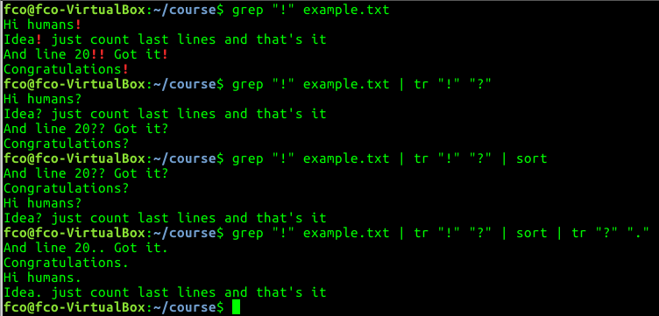
Examples

Slide 33
Exercise (4)
Print 1st column of exercise.tsv and store the output in a new file called exercise2.tsv
Add to exercise2.tsv, the first 5 lines of exercise.tsv
Find ‘:’ in exercise2.tsv. Convert ‘.’ to ‘,’. Store the output in new file called exercise3.tsv

Slide 34
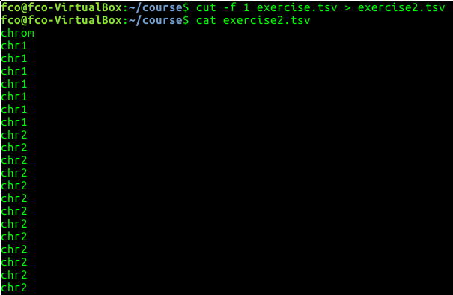
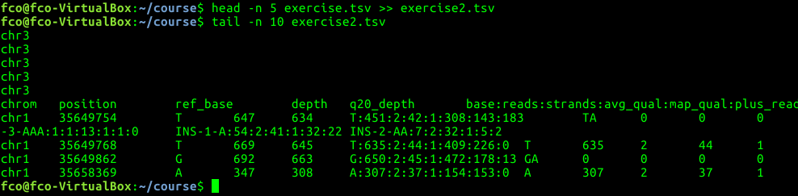
Exercise (4)
Print 1st column of exercise.tsv and store the output in a new file called exercise2.tsv
Add to exercise2.tsv, the first 5 lines of exercise.tsv
Find ‘:’ in exercise2.tsv. Convert ‘:’ to ‘,’. Store the output in new file called exercise3.tsv

Slide 35
Linux commands (4). Other useful commands
man [command] → Get the manual of [command]
wc [file] → Print newline, word, and byte counts of [file]
history → Print all the commands used
clear → “Cleans” the terminal
echo [“Some words”] → Prints [“some words”] in the terminal

Slide 36
Exercise (5)
What is the parameter in ‘wc’ command to print only the number of lines that file has?
Print all the ‘cd’ command you have used during the course

Slide 37

Exercise (5)
What is the parameter in ‘wc’ command to print only the number of lines that file has?
Print all the ‘cd’ command you have used during the course

Slide 38
Merging all
We can combine different instructions if needed
#!/bin/bash
#Do all exercises at once
cd /home/fco #Go to home folder
mkdir course #Create new folder
cd course #Go to folder
touch ex2.sh #Create new blank file
cp /media/ffuster/USB/exercise.tsv . #Copy example exercise from the USB.
tr ':' '-' < exercise.tsv > exercise2.tsv #Change ‘:’ to ‘-’ in the file and store the ouput in a new file
sort exercise2.tsv > exercise3.tsv #Sort the file and store it in a new file

Slide 39
Merging all
We can combine different instructions if needed
#!/bin/bash
#Do all exercises at once
cd /home/fco #Go to home folder
mkdir course #Create new folder
cd course #Go to folder
touch ex2.sh #Create new blank file
cp /media/ffuster/USB/exercise.tsv . #Copy example exercise from the USB.
tr ':' '-' < exercise.tsv > exercise2.tsv #Change ‘:’ to ‘-’ in the file and store the ouput in a new file
sort exercise2.tsv > exercise3.tsv #Sort the file and store it in a new file
My first bash script!!

Slide 40
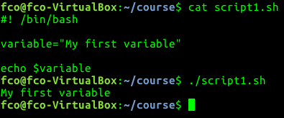
Bash scripts. Variables
Pieces of code that can get whatever value
Special variables:
$1 - $9 → Get the value of first - ninth option
…

Slide 41
Bash Scripting. If statement
Piece of code that will be executed if a condition is true
#!/bin/bash
#My first if statement
if [ condition ]
then
[Commands that will be executed if condition is true]
else
[Commands that will be executed if the condition is false]
fi

Slide 42
Bash Scripting. If statement
Piece of code that will be executed if a condition is true
#!/bin/bash
#My first if statement
if [ condition ]
then
[Commands that will be executed if condition is true]
else
[Commands that will be executed if the condition is false]
fi

Slide 43
Bash scripting. For loop
Piece of code that will be executed several times
#!/bin/bash
#My first for loop
for ( )
do
[Commands that will be executed several times]
done

Slide 44
Bash scripting. For loop
Piece of code that will be executed several times
#!/bin/bash
#My first for loop
for ( )
do
[Commands that will be executed several times]
done

Slide 45

Cluster

Slide 46
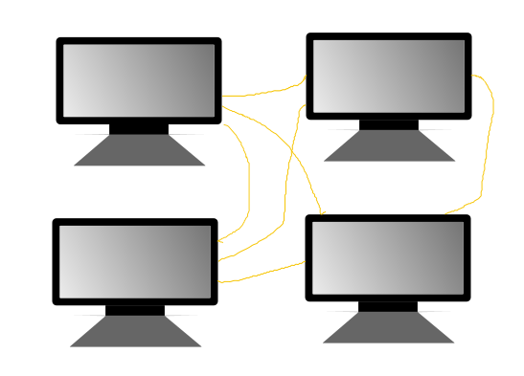
Cluster

Slide 47
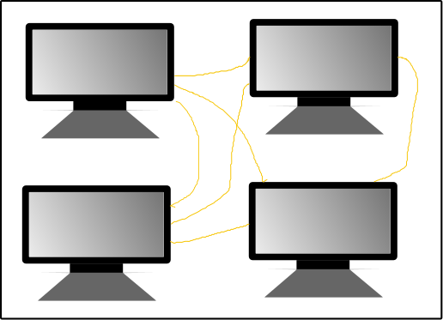
Cluster

Slide 48
Queuing system
Orders the jobs sent to cluster according to priorities
SGE
SLURM
...

Slide 49
SGE useful commands
qsub [bash_script] → Sends [bash_script] to cluster
qstat →Check cluster status
qdel → Delete a job from cluster

Slide 50
Exercise (6)
Copy cluster_template.sh to your course folder
Modify cluster_template.sh, with your name
Send the job to cluster
Check the cluster status

Slide 51
Exercise (6)
Copy cluster_template.sh to your course folder
Modify cluster_template.sh, with your name
Send the job to cluster
Check the cluster status

Slide 52
Additional exercises (1)
Print last 10 lines of exercise.tsv, but excluding last one
Print 2nd column of exercise.tsv, sort the output and store it in a new file called exercise2.tsv
Find the files in course folder that starts with ‘ex’ and has ‘2’ in the name
Print 6th column of exercise.tsv, change ‘:’ to ‘,’ and sort the output. Append the output to exercise2.tsv

Slide 53
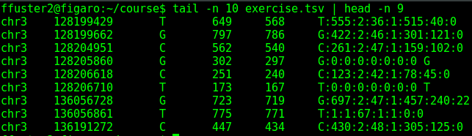
Additional exercises (1)
Print last 10 lines of exercise.tsv, but excluding last one
Print 2nd column of exercise.tsv, sort the output and store it in a new file called exercise2.tsv

Slide 54
Additional exercises (1)
Find the files in course folder that starts with ‘ex’ and has ‘2’ in the name
Print 6th column of exercise.tsv, change ‘:’ to ‘,’ and sort the output. Append the output to exercise2.tsv

